Slide 1
Evolutionary Algorithm framework for Controlling Strategies of a Batbot
Thesis Proposal
Anuar Santoyo alum 安武 2022280136
Supervisor: Prof. ZHAN YUN张云
2023/05/25

Slide 2
introduction

Slide 3
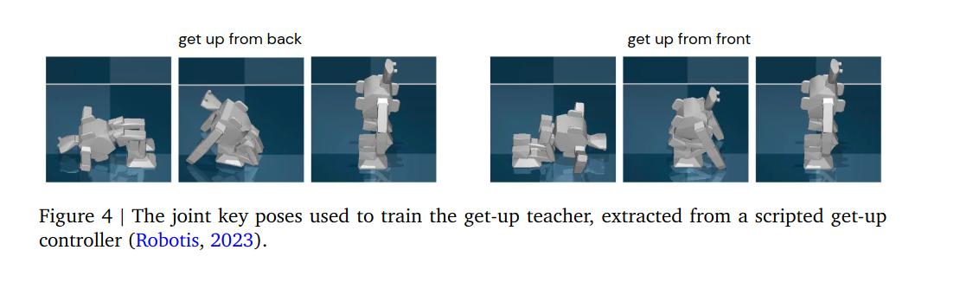
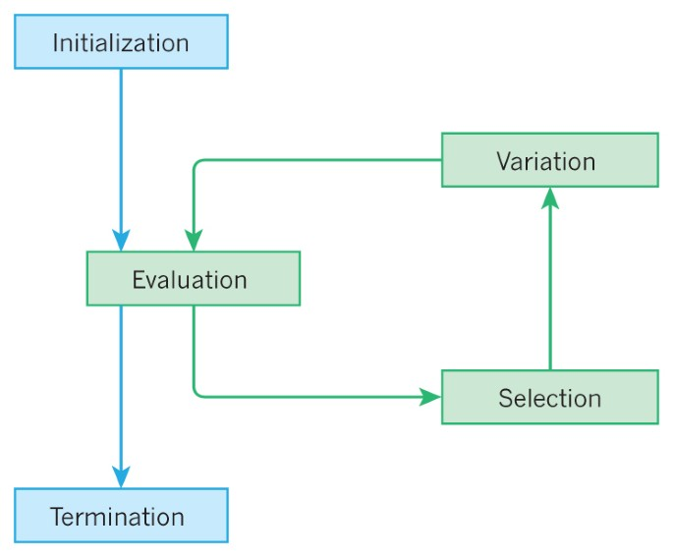
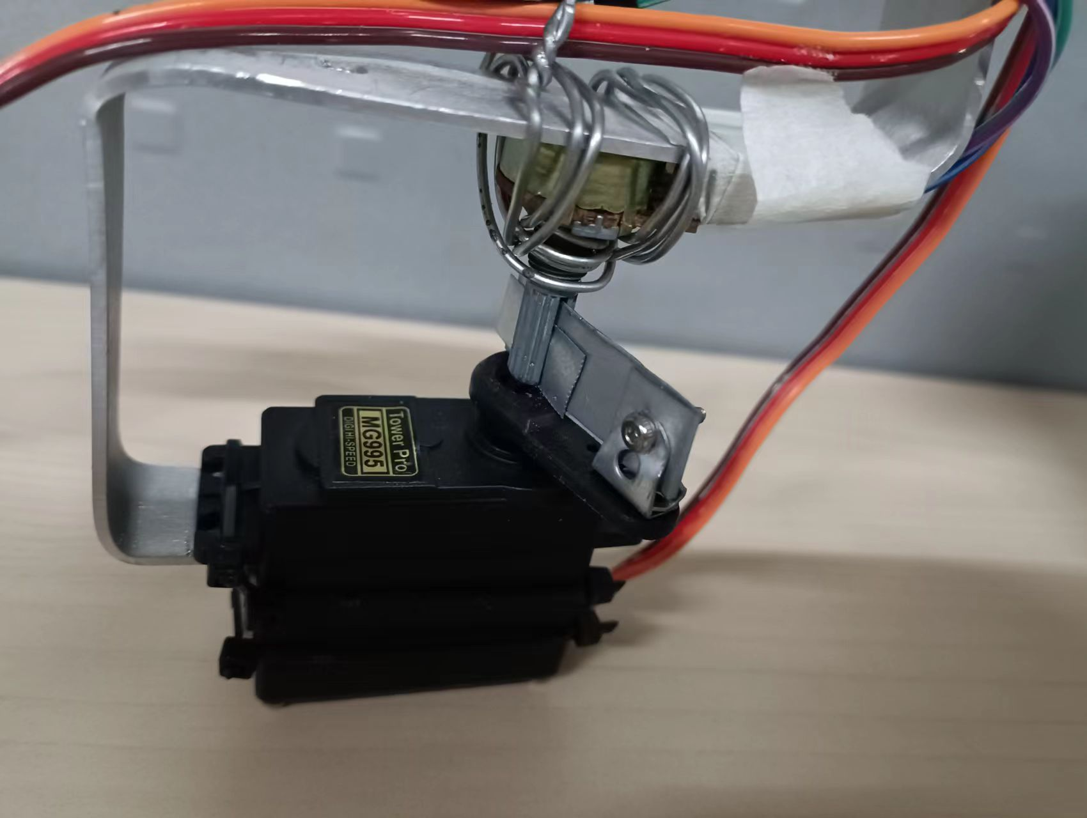
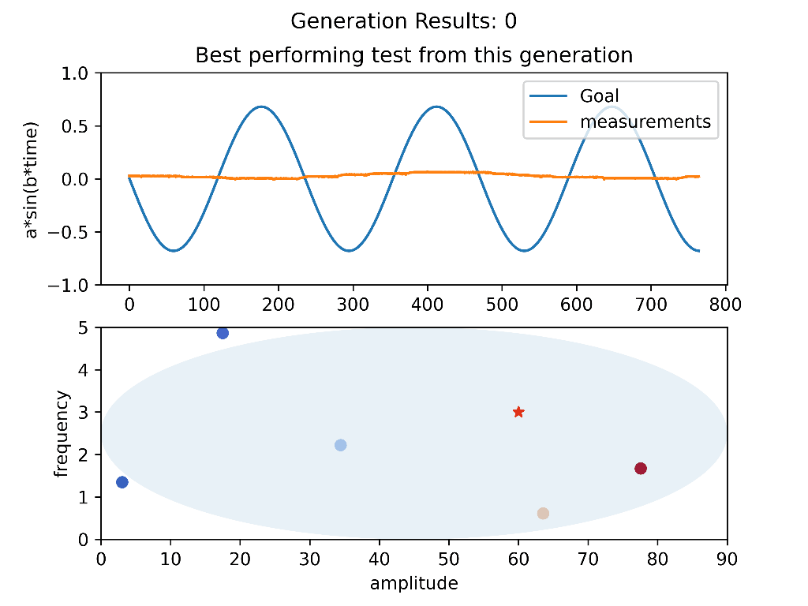
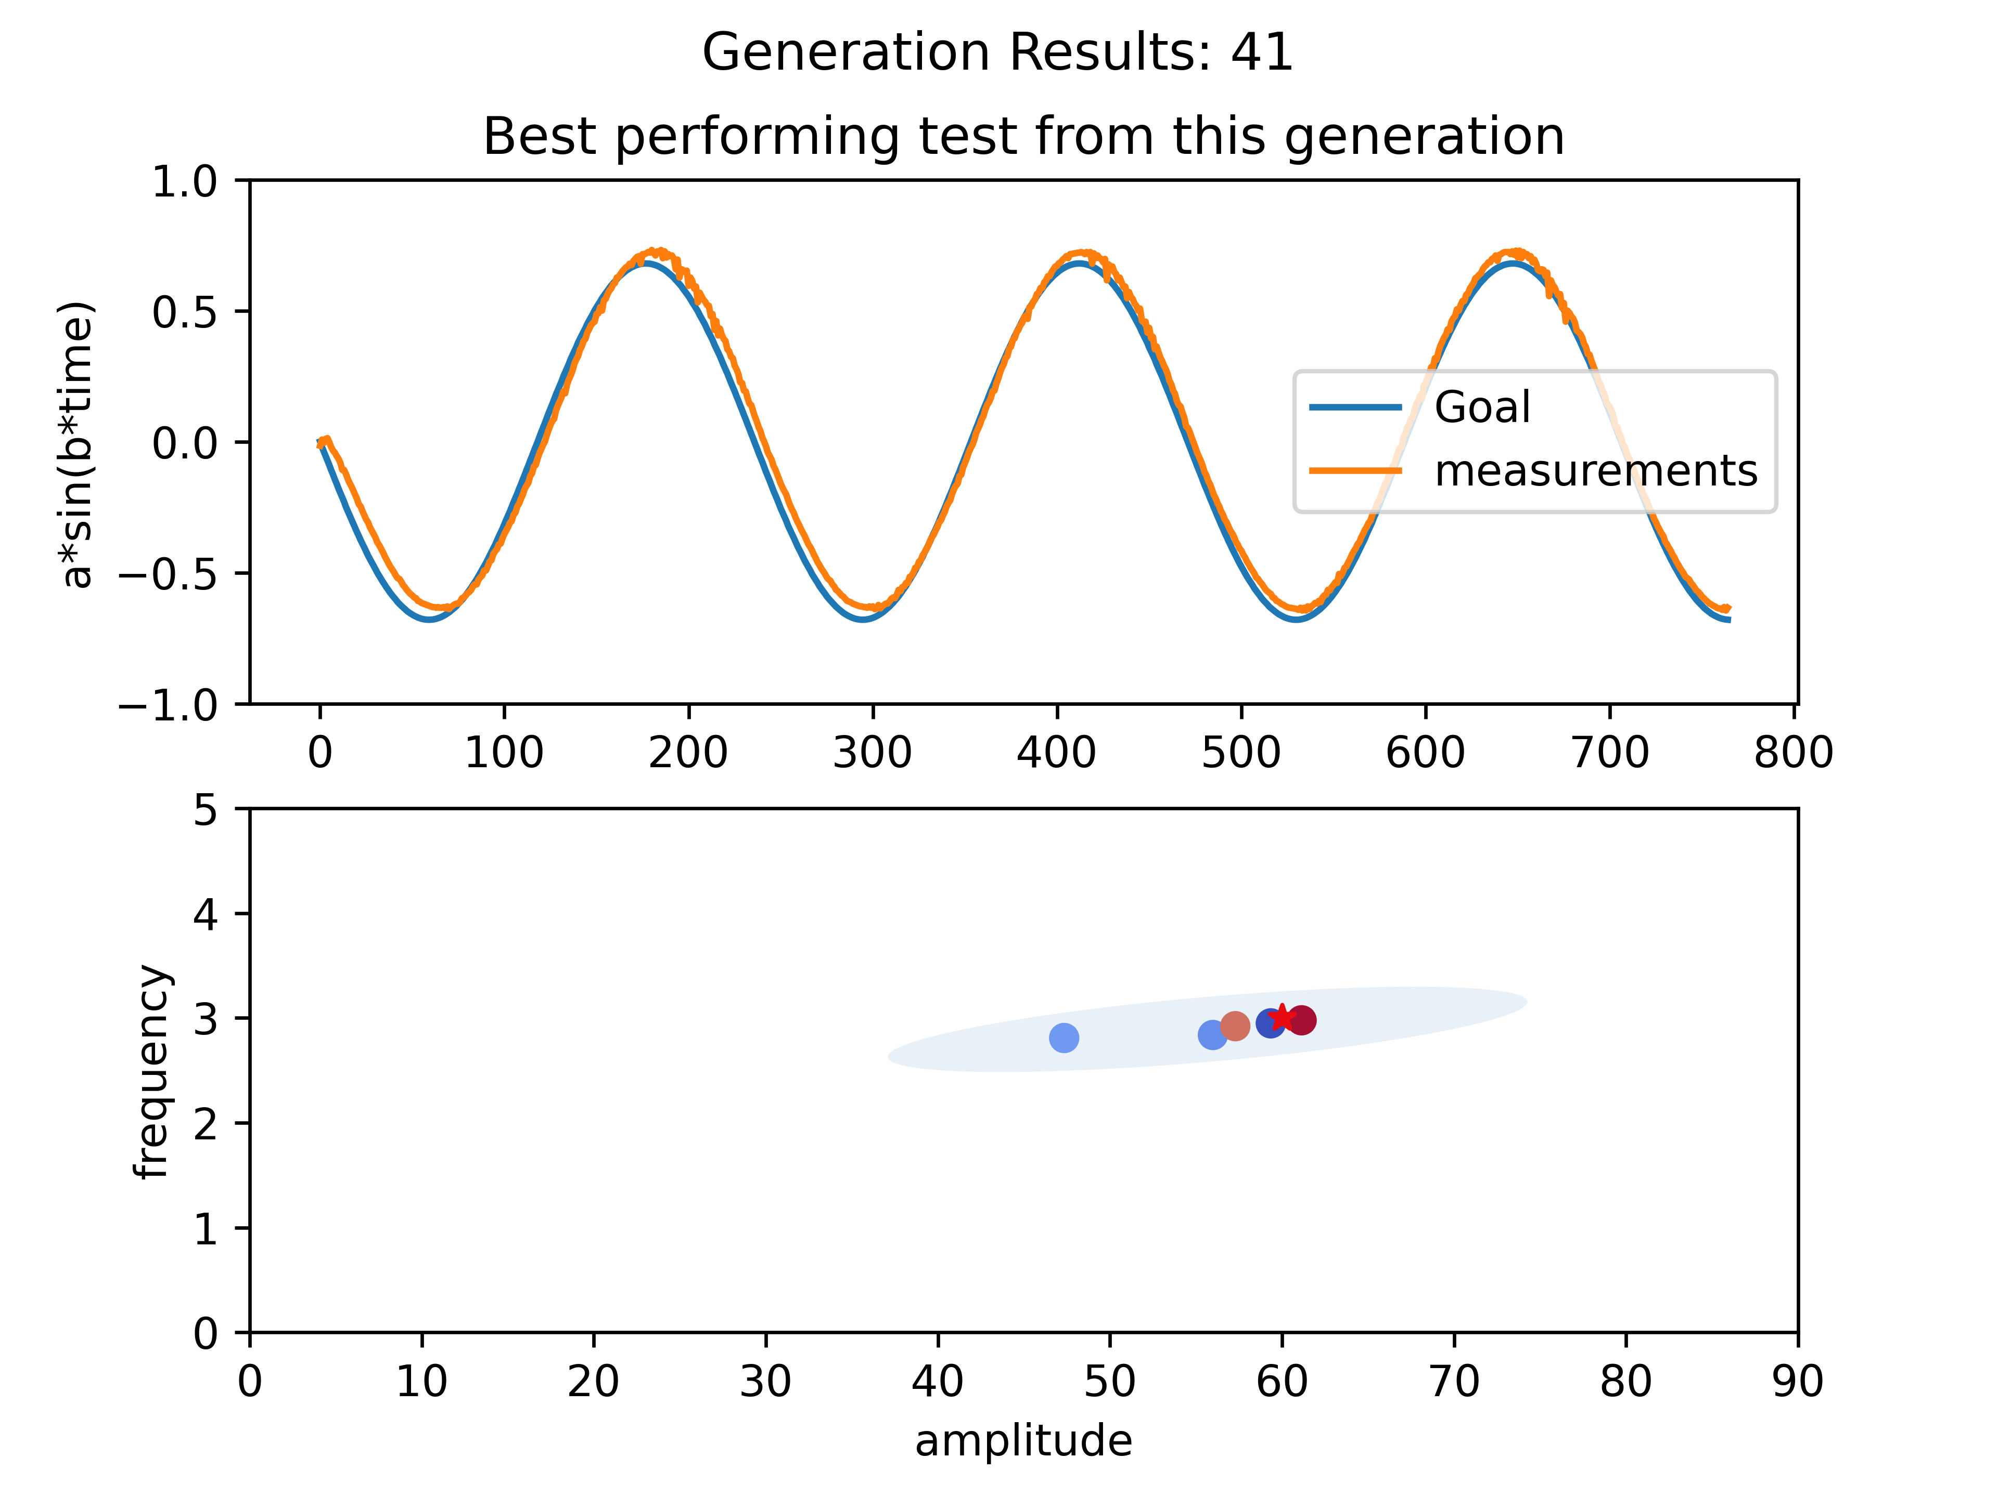
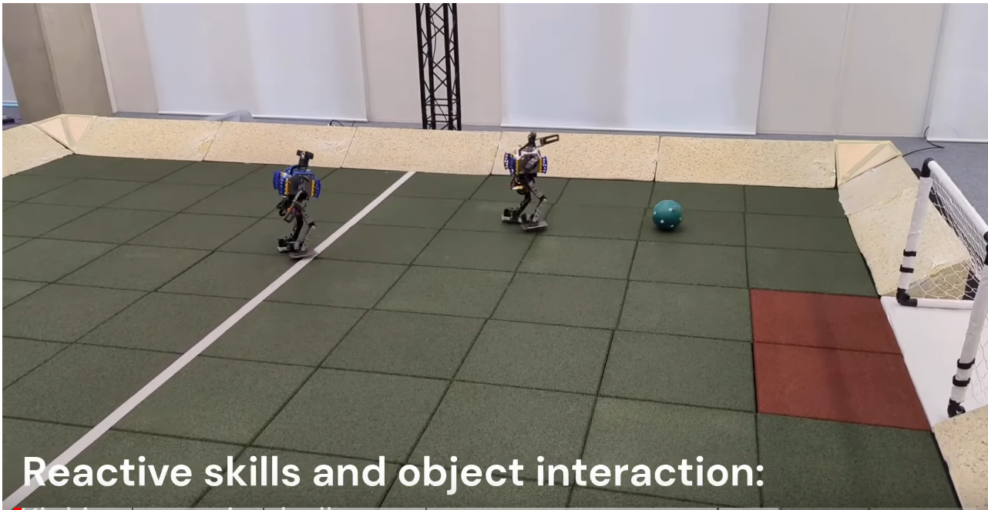
introduction
Evolutionary Algorithm
Extensive application in controlling strategies (PID, Fuzzy Controller, Neural Network)
In 2016 Covariance Matrix Adaptation (CMA) is introduced.
Most of research done in simulations or were adapted from simulations to reality. “There is a large gap between theory and reality”-Adam Slowik, Evolutionary algorithms and their application to eng. problems, 2020
What happens if a simulation is not possible?
Eiben, A., Smith, J. From evolutionary computation to the evolution of things. Nature 521, 476–482 (2015). https://doi.org/10.1038/nature14544
arXiv:2304.13653
A. Bagis, “Determination of the pid controller parameters by modified genetic algorithm
for improved performance.” J. Inf. Sci. Eng., vol. 23, pp. 1469–1480, 09 2007. Fig 7.

Slide 4
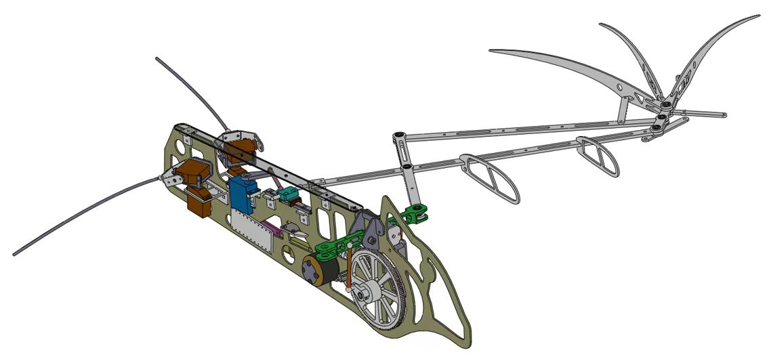
introduction
Batbot hovering
Not suitable for multiple simulations: elastic membrane, interaction with fluids.
Can we develop a framework to test if evolutionary algorithms can be used to improve hovering control performance?
Biggest problem on real world training? → High dimensionality
How to solve it?

Slide 5
methodology
Explanation of the 3 phases

Slide 6
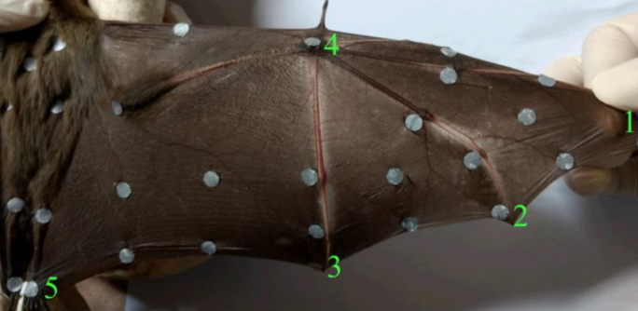
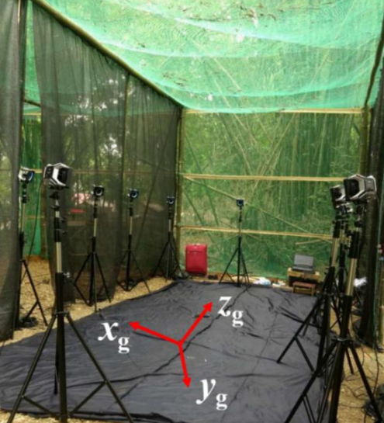
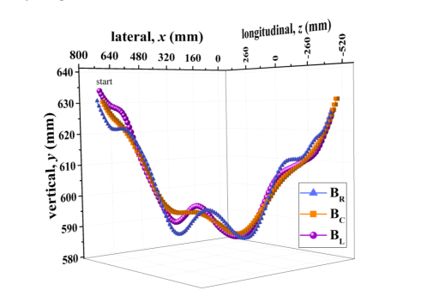
Phase 1: flight dynamic analysis
1. Real bat data
From Dr. Sudeep Kumar Singh Disseratation “Kinematic Analysis of a Bat Flight Based on Membrane Wing Motion Reconstruction”, 2022

Slide 7
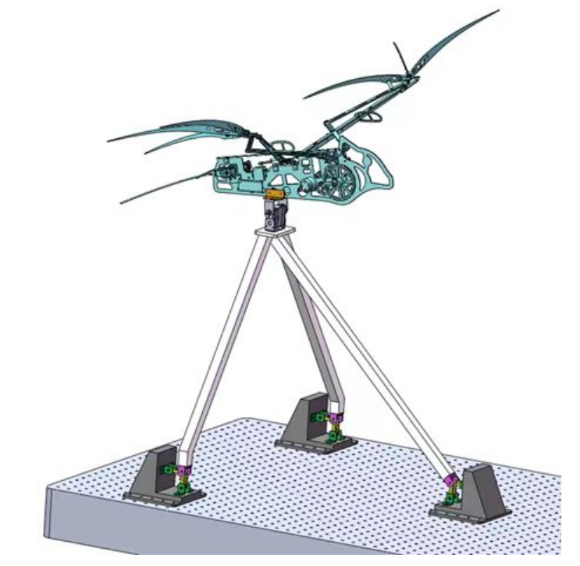
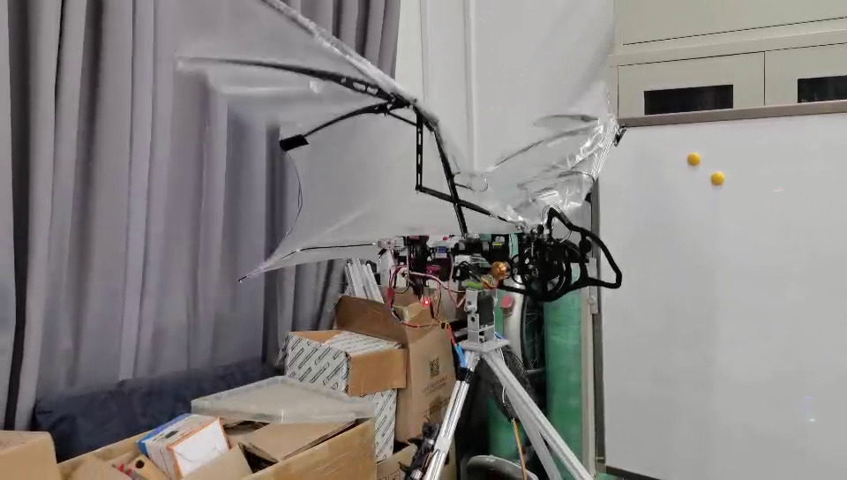
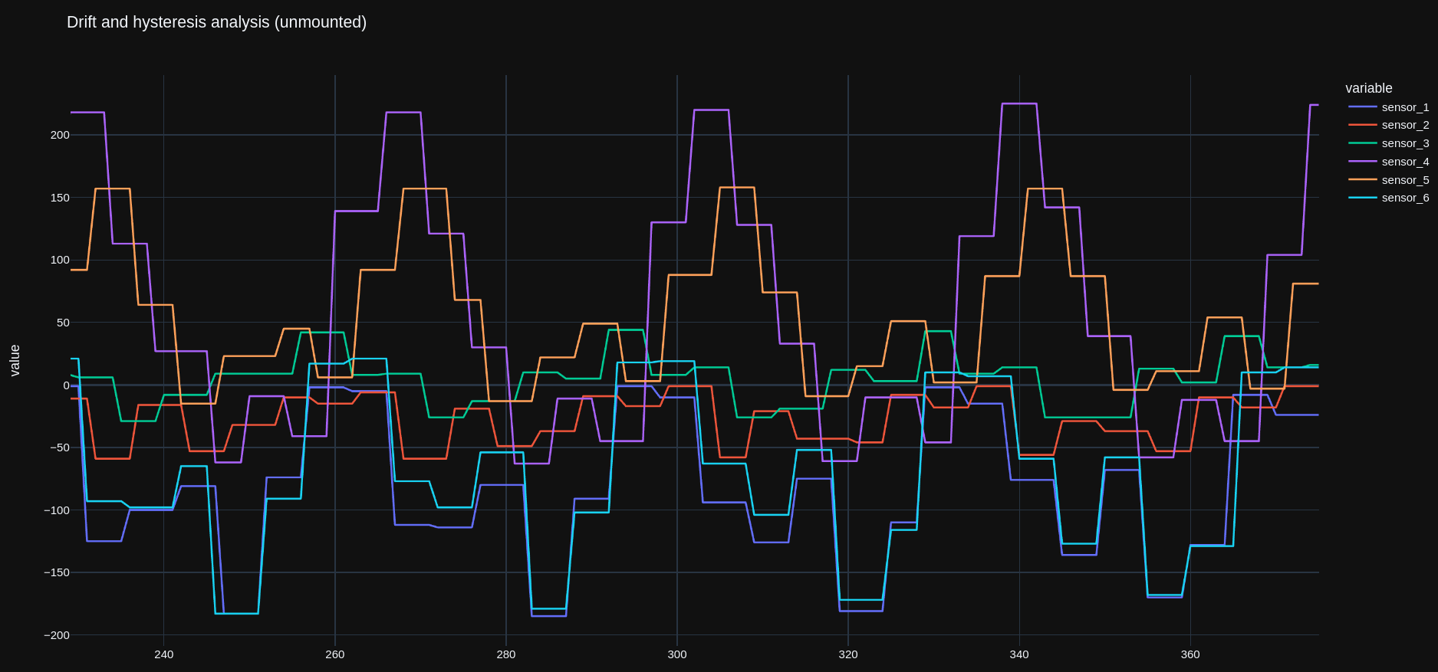
Phase 1: flight dynamic analysis
2. static test-bench tests

Slide 8
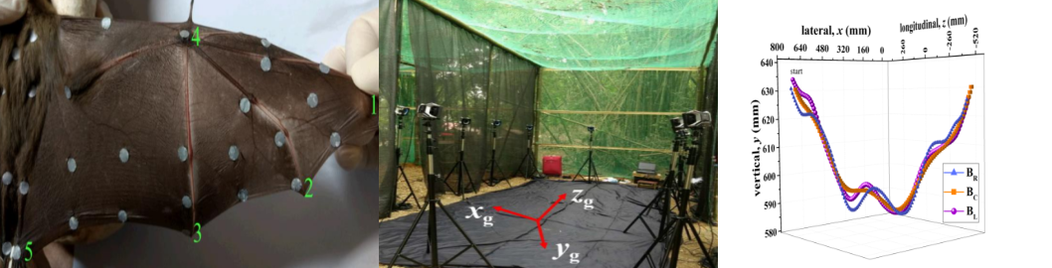
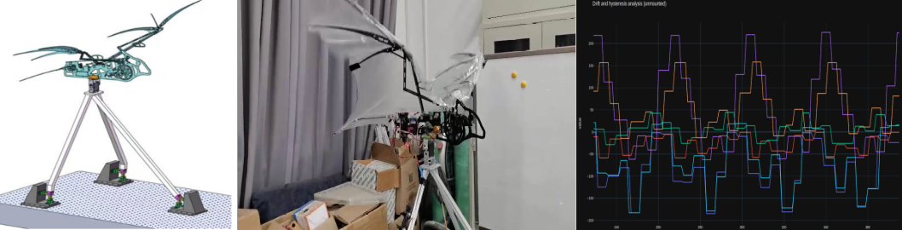
Phase 1: flight dynamic analysis
Real bat data
GENERAL OPEN LOOP CONTROLLER: OC(θ) Being θ the optimizatioN VECTOR
+
=
θ = [frequency, horizontal angle, leg amplitude]
Example:
static test-bench tests

Slide 9
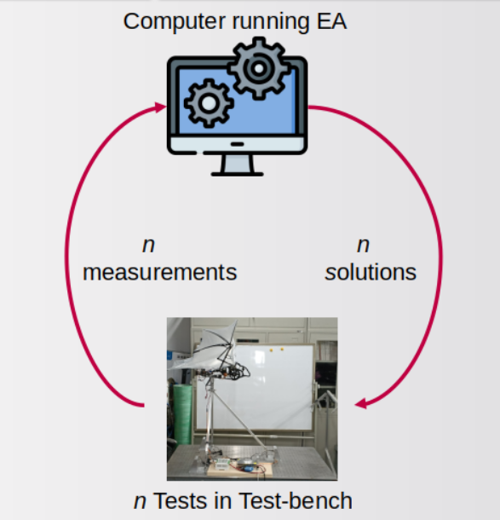
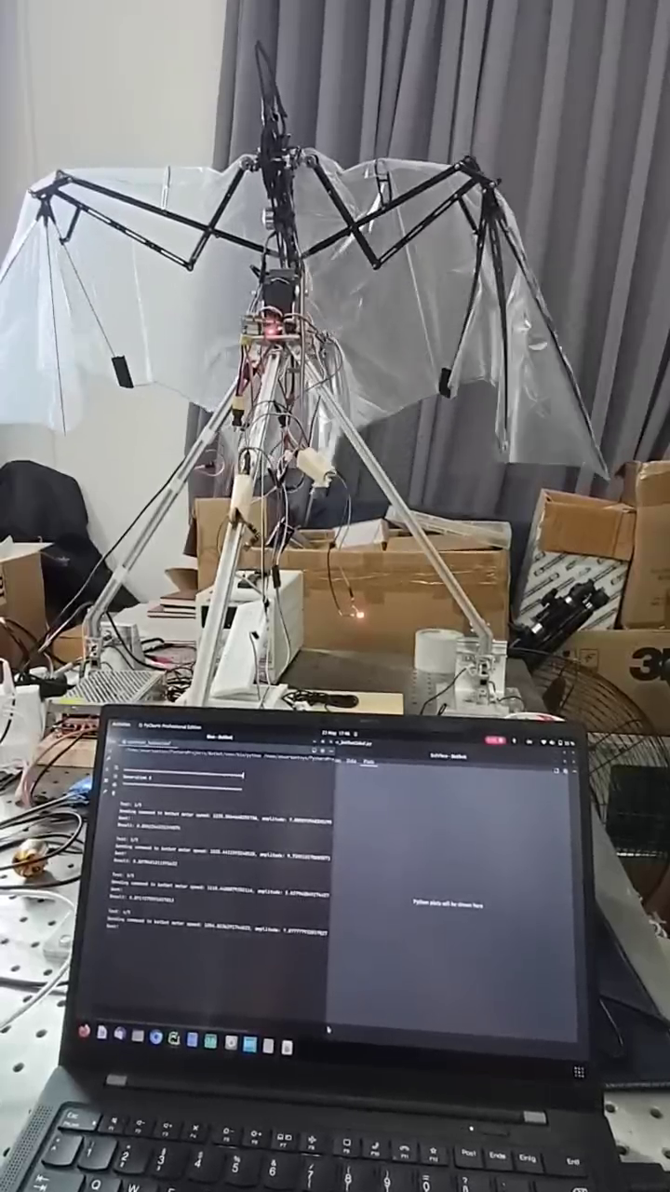

Phase 2: OPEN LOOP CONTROLLER OPTIMIZATION
PRELIMINARY EXPERIMENT
TRAINING CYCLE
THE RESULT OF PHASE 2 IS AN OPTIMAL OPEN LOOP ALGORITHM. (NO FEEDBACK YET)

Slide 10
Phase 3: feedback controller optimizer
Feed back controller
OPEN-LOOPoptimal
TO OPTIMIZE
Input
Error
FEEDBACK
CONTROLLER
(PID, Fuzzy, NN, ...)
BATBOT
Output
SENSORS
(Barometer, IMU,...)

Slide 11
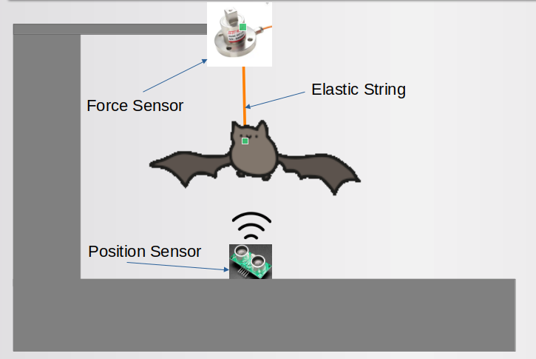
Phase 3: feedback controller optimizer
DYNAMIC TEST BENCH
Dynamic fitness function
String sensor to incentivize hovering
Position sensor for centering
Result of phase 3
Optimized feedback controller

Slide 12
conclusion
Final remarks

Slide 13
Final remarks
How to solve high dimensionality problem?
Divide problem in 3 sub-tasks to give directionality to optimization process.
Real bat data and flight dynamic analysis provide heuristic to reduce dimensionality.
Covariance matrix adaptation restricts the search area of the remaining dimensions
To conclude, the fitness functions will be used to assert if the proposed framework enabled the progressive optimization of hover control algorithm.

Slide 14
Thank you for you attention!
I am open for any questions

